Slide 1

Security guys

Slide 2
Risks
Open to data loss
Open to malware attacks to the whole central server
No back-up system in terms
No Rights to Logs
Corrupted server information loss

Slide 3

PREVENTION
Website filters – controlled by the admin panel
Cloud backs – to protect central server
Security policy
Security training – introduce (chaos monkey)
Standard security software for all devices
Encrypt all messages that relayed on the network
IT inspection of hardware – no Jailbreak Devices on site.

Slide 4

Detection
Daily checks on any threats in the system
Set-up an alert system for any users that are breaching the security policy
Flag – Antivirus system

Slide 5

Response
Isolate the server from the computer or from the network
Update the security systems/software if breached
Have a kill switch and use the cloud backed data to restart the server and maintain the updated software to work with.
Document the details of the breach and logging all names, time and date of attack.
Reporting to those in charge – system admins

Slide 6
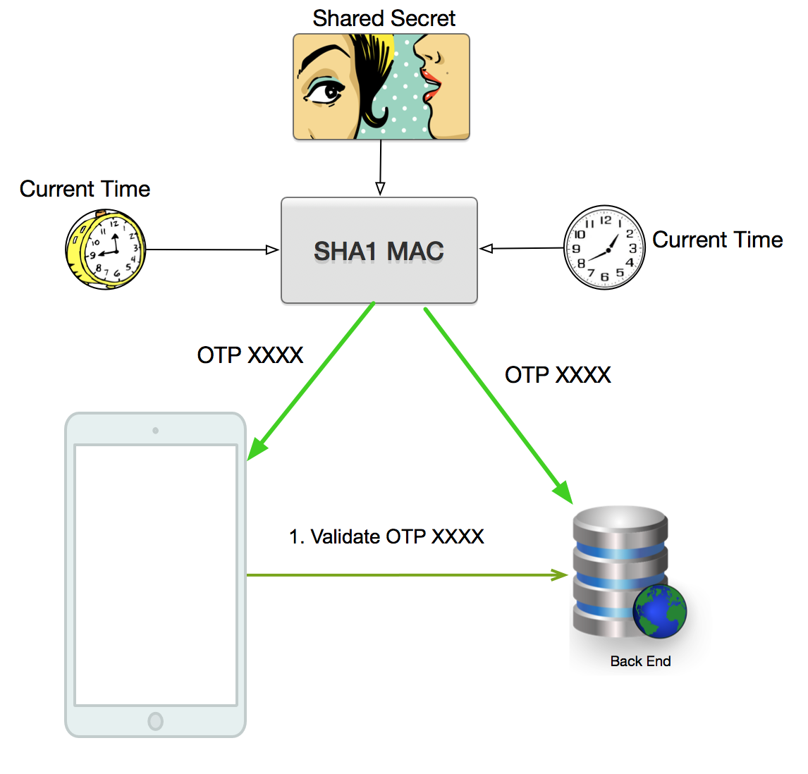
Analysis
Identify the type of attack
How severe is the attack?
Have we logged this kind of attack before?
Redevelop measures of avoiding the same attack from happening.

Slide 7

Thank You
someone@example.com

